Slide 1
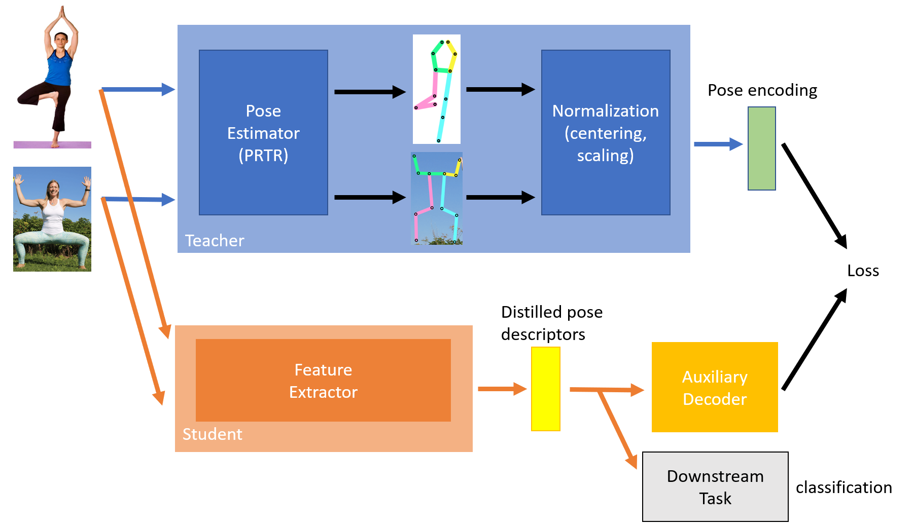
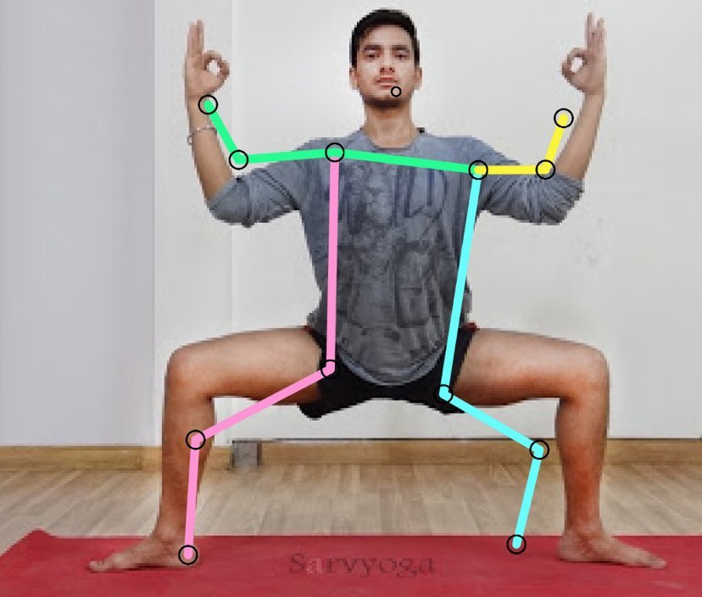
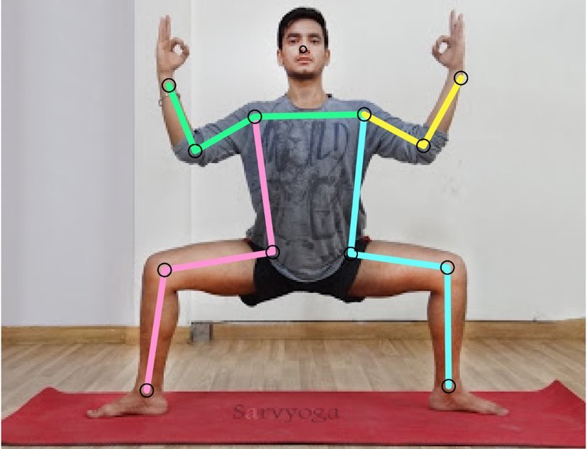
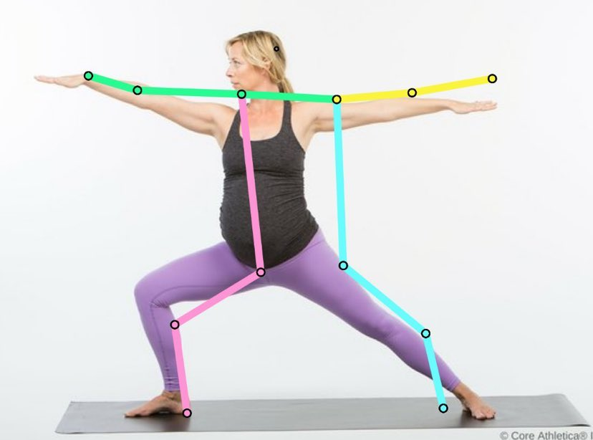
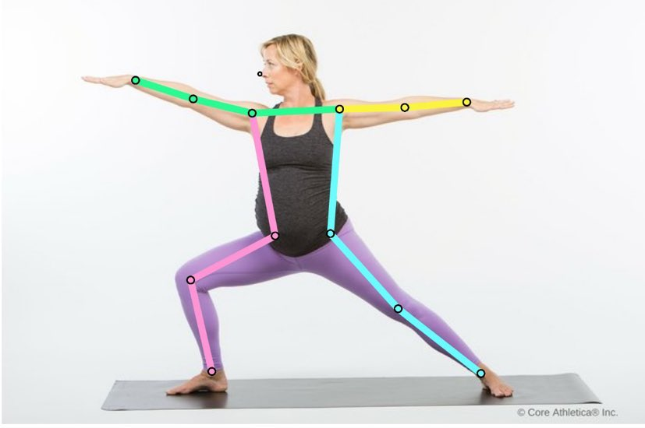
Meta Learning Model
for Keypoint Coordinate Prediction and Pose Classification
Deep Learning Final Project
Group 13
林子淩, 黃亭晅, 陳泳翰
Abstract
We developed a keypoint prediction method incorporates PRTR (Pose Recognition with Cascade Transformers) into the Yoga Pose Classification Dataset obtained from Kaggle. Our method introduces a keypoint detection step and meta-learning to enhance the classification accuracy by utilizing keypoint information. We conducted experiments to evaluate the effectiveness of our approach compared to a model trained without incorporating it. This allows us to assess the impact of our keypoint prediction method on the classification performance.
Dataset
Yoga Poses Dataset from Kaggle is a diverse collection of labeled images representing various yoga poses. It features a substantial number of images covering a wide range of poses. The dataset includes pose names, difficulty levels, and descriptions. Researchers can leverage this dataset to develop machine learning models for pose recognition, estimation, and classification tasks.
Experiments Result
pretrained | include head points | image size | test acc | baseline
✖ | 13 | 512x512 | 74.75 (+2.78) | 71.97
✔ | 13 | 512x512 | 82.24 (+3.05) | 79.19
✖ | 13 | 384x288 | 77.24 (+0.55) | 76.69
✔ | 13 | 384x288 | 87.14 (+1.57) | 85.57
✖ | 12 | 384x288 | 79.46 (+0.46) | 79.00
✔ | 12 | 384x288 | 85.57(+0.19) | 85.38
Framework
pose label
Table 1. Classification accuracy comparison between w and w/o our method.
pretrained | include head points | image size | test keypoint loss
✖ | 13 | 512x512 | 0.0252
✔ | 13 | 512x512 | 0.0243
✖ | 13 | 384x288 | 0.0247
✔ | 13 | 384x288 | 0.0240
✖ | 12 | 384x288 | 0.0247
✔ | 12 | 384x288 | 0.0238
Figure 1. The framework of our training method.
Methodology
The overall architecture is shown in the diagram above. Initially, the image is fed into both the PRTR model and the meta learning model simultaneously. PRTR model employs a pretrained weight to predict the keypoints in images, which are then subjected to normalization operations to provide keypoint coordination label. On the other hand, the meta learning model jointly learns two task, which are the keypoint coordination prediction and pose classification, respectively. Since we assume that by training both task in the same pipeline and sharing the feature extractor, the model can transfer knowledge learned from one task to another, leading to improved generalization performance. Additionally, joint training facilitates the simultaneous optimization of the feature extractor across multiple tasks, encouraging the learning of a shared feature representation that is applicable to diverse tasks.
Table 2. The MSE loss between our model and PRTR labels.
Result Visualization
ResNet18 PRTR
Figure 2. Comparison of keypoint prediction result of pretrained PRTR and meta learning model.

